Slide 1
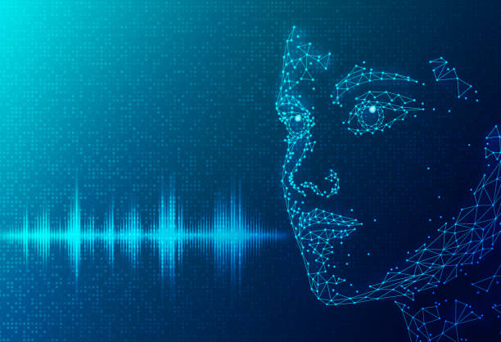
Speech Emotion Recognition
Presentation By :
Amarnath reddy Pamireddygari
Venkata Naga Sandeep Gude

Slide 2
Project statement
The project is to develop and implement a Speech Emotion Recognition (SER) system that accurately classifies the emotional states expressed by spoken language. Sentiment analysis, human-computer interaction, mental health monitoring, and customer service are among the fields in which emotion recognition from speech has applications.

Slide 3
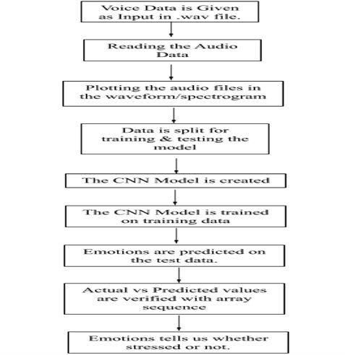
Approach
In this project, a dataset of 24 actors is used and their voices to build a model using algorithms like convolution neural network, MFCC technique, data making/ processing, Librosa are used. Five different emotions like sad, angry, happy, calm, fear are given in this model with actors voice. Noise from the audio’s also removed and user voice is given to the model and model predict the emotion.

Slide 4
Deliverables
A model is developed to detect the emotion of a speaker by using
python programming code and algorithms.
A GitHub repository link for project code.
Code walkthrough video on YouTube.
.

Slide 5
Evalution methodology
The machine Learning model is trained by using various algorithms which are mentioned in above slides will be used to analyze the emotion of a user and also a gender. By using Librosa package we extracted the features of a audio files to find the emotion of a user.

Slide 6
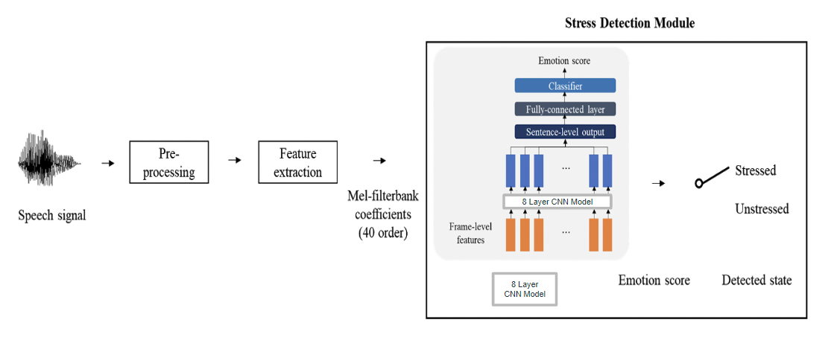
Module for Speech Emotion Recognition

Slide 7
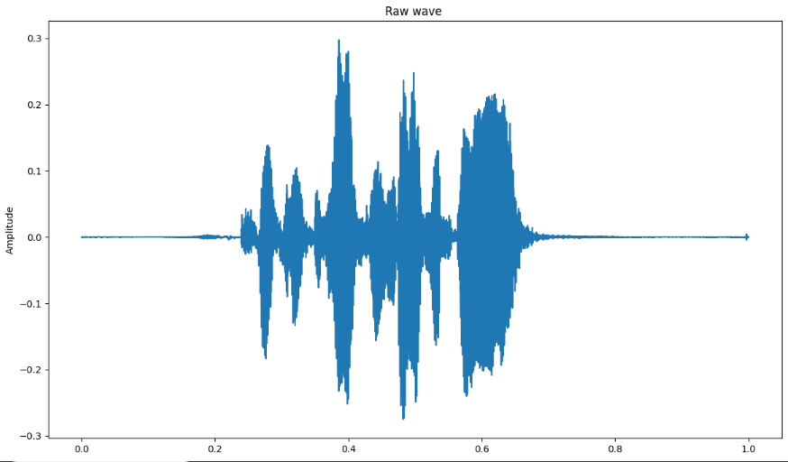
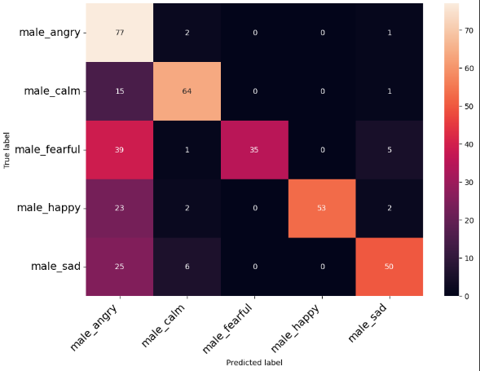
Audio wave Confusion matrix

Slide 8
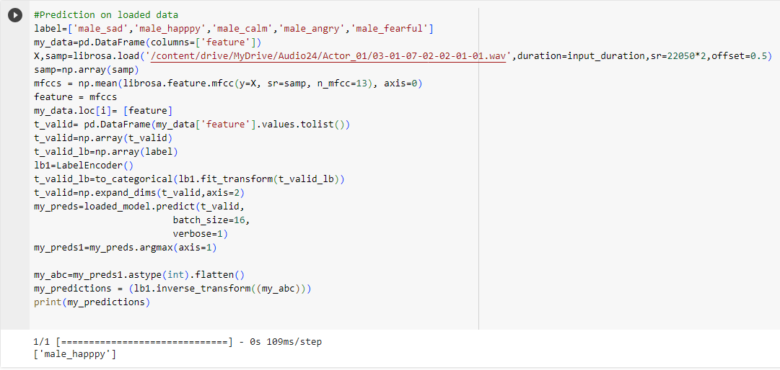
Results The output of our model shows the emotion of a user by taking the input audio.

Slide 9
THANK YOU

